Slide 1
Coral Telemetry
DR
BA1435
July 2012
Rev A2

Slide 2

Topics
Spec
Block diagram
Schematic
Mechanics
Software
Schedule

Slide 3
General
The link is a C-Band FM Telemetry link . Includes 5W Transmitter and telemetry Receiver. The antenna is part of the enclosed unit. Each unit transfers RS422 Data. The unit is also controlled by RS422 protocol.

Slide 4


SPEC-TX
Frequency:
        5.15 – 5.25GHz ,
        2. 5.725- 5.825GHz
Frequency Step: 1MHz (controlled via RS422 )
Frequency Stability: ± 2.5 ppm max (-20°c ÷ +70°c)
Power Output: 5W max ( Low power option-1W)
Harmonic Level: 70dBc min.
Output Impedance: 50 Ohm, VSWR 1.5:1 max
Deviation: 0.7 X 9Mbps
Frequency Response: 9MBPS.
MIL-STD operates from 28V

Slide 5
SPEC-RX
Frequency:
        5.15 – 5.25GHz ,
        2. 5.725- 5.825GHz
Frequency Step: 1MHz (controlled via RS422 )
Frequency Stability: ± 2.5 ppm max (-20°c ÷ +70°c)
RF Rejection : 1W @ 200MHZ from CF
Sensitivity: -85dBm
Image Rejection : 40dB
IF BW: 10MHz
  Pin max : +10dBm
Frequency Response: 9MBPS.
MIL-STD operates from 28V

Slide 6
Antenna
TX:
  Integrated antenna: BA3100
  frequency: 5100 - 5900 MHz
  V.S.W.R (or Return Loss): < 1.5:1 ( or > 14dB)
  Gain: >9.5dBi
  Beam Width: 60° x 60°
RX:
  Integrated antenna: BA3150
  frequency: 5100 - 5900 MHz
  V.S.W.R (or Return Loss): < 1.5:1 ( or > 14dB)
  Gain: >18dBi
  Beam Width: 32° x 20° (VER X HOR )

Slide 7
Safe Distance from Tx Antenna
For 1mW/CM^2
Tx power : 5W
Antenna Gain: 10dBi
The Safe distance is at list 1-2m from antenna

Slide 8
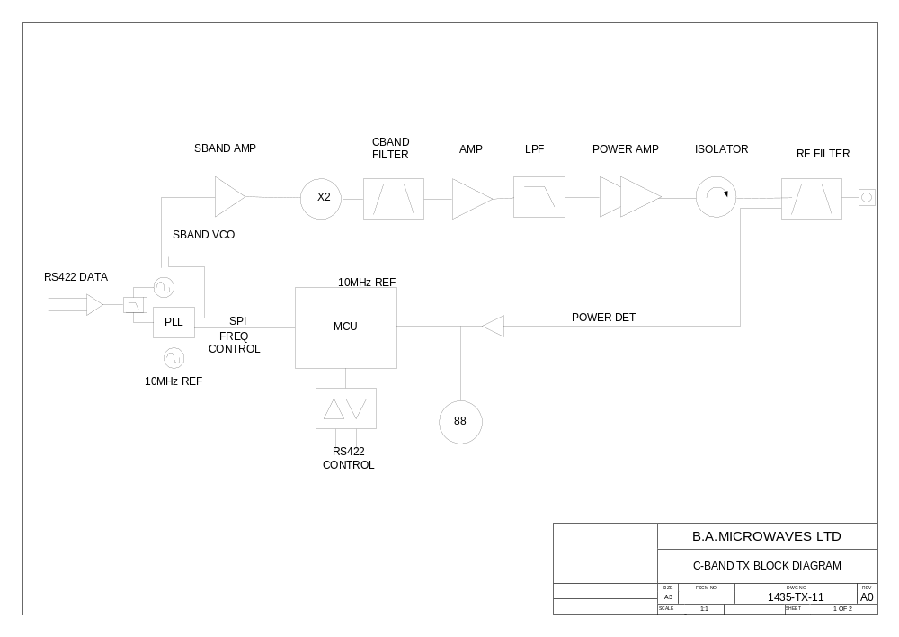
TX Block Diagram

Slide 9
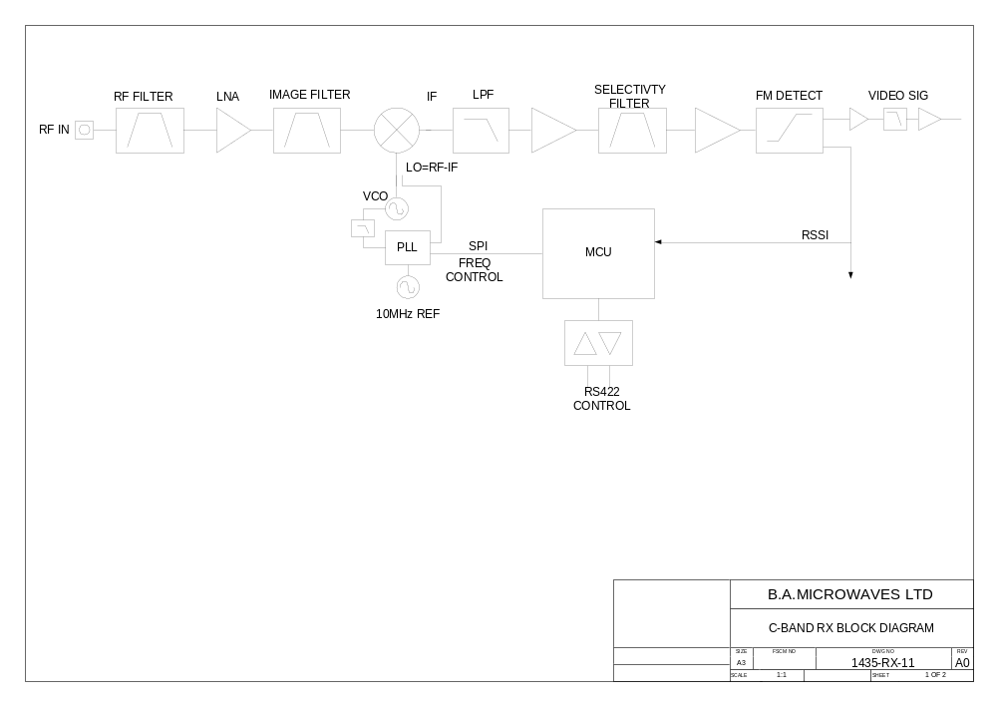
RX Block Diagram

Slide 10
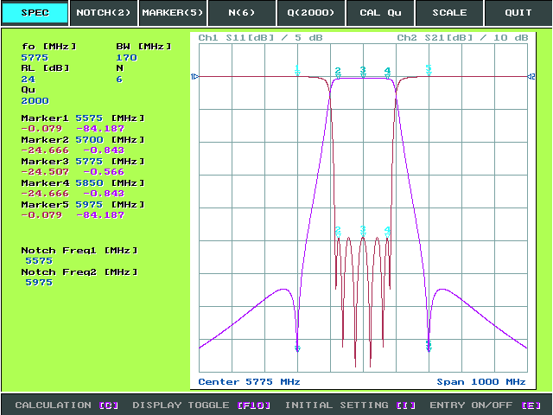
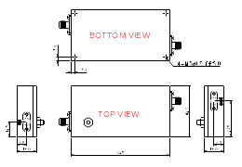
RF FILTER SPEC
Center Frequency | Mhz | 5775
Frequency Range | Mhz | 5700~5850 (150Mhz)
Insertion Loss in B.W | dB | 1.0 (Max)
Ripple in B.W | dB | 0.5 (Max)
Return Loss in B.W | dB | 18 (Min)
Attenuation | dB | 60 Min @ Fc±200MHz
Input Power | W | 10CW (Max)
In/Out Impedance | Ω | 50
Operating Temperature | ˚C | -20 ~ +70
Connector | - | SMA (Female) – All Ports
Finish | - | Black Epoxy Painting

Slide 11
Rx Filter Calculation
Receiver IP1dB = -20dBm
Rejection of 60dBc +/-200MHz
10dB Back-off from IP1dB for no affect on RF.
-20-10+60 = +30dBm .
1W of interfering signal into the unit will not affect the device .

Slide 12
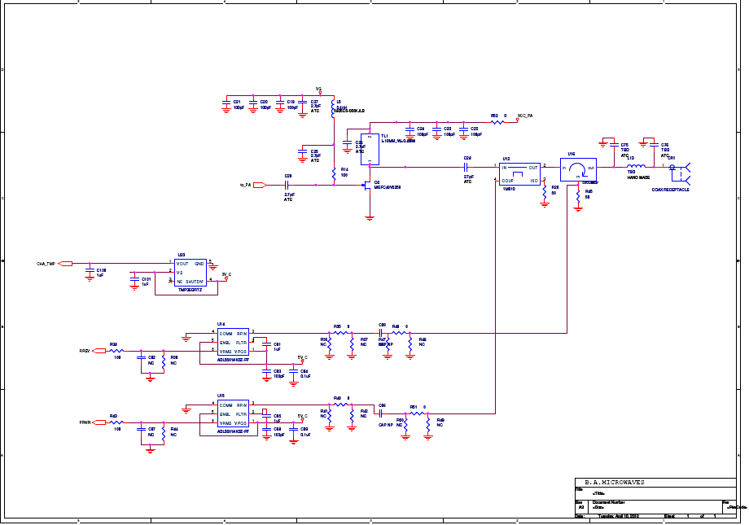
Tx Schematic
PA

Slide 13
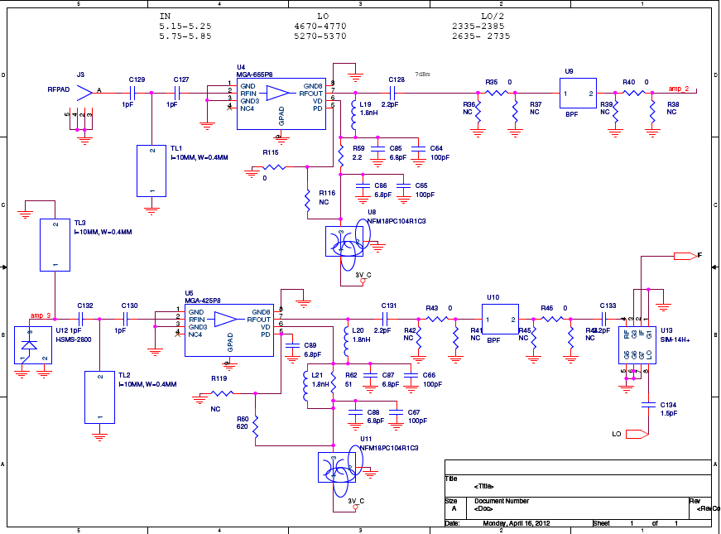
Rx Schematic
RX FE

Slide 14
Power Consumption
From 28V
TX: 1.6A
RX: 0.2A

Slide 15
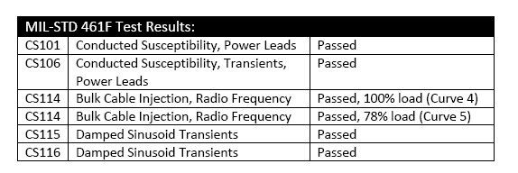
Power supply EMI STD
The power supply and Input DC Filter comply with the following MIL-STD .
MIL-STD-461F

Slide 16
Mechanics-TX
D38999/24WB35PN (
Supply voltage
Supply voltage
Supply returned/ GND
Supply returned/ GND
Mod in RS422 (+)
Mod in RS422 ( -)
Control OUT RS422 (+)
Control OUT RS422 (-)
Control In RS422 (+)
Control In RS422 (-)
GND
NC
NC

Slide 17
Mechanics Tx - Cont
Weight:2.8Kg Excluding Electronics . ~3.2Kg Final
IP65
Based on Box model:
Color : White
  MIL-C-85285 POLYURETHANE WHITE GLOSS 17925 PER FED-STD-595
Carry on case supplied by customer

Slide 18
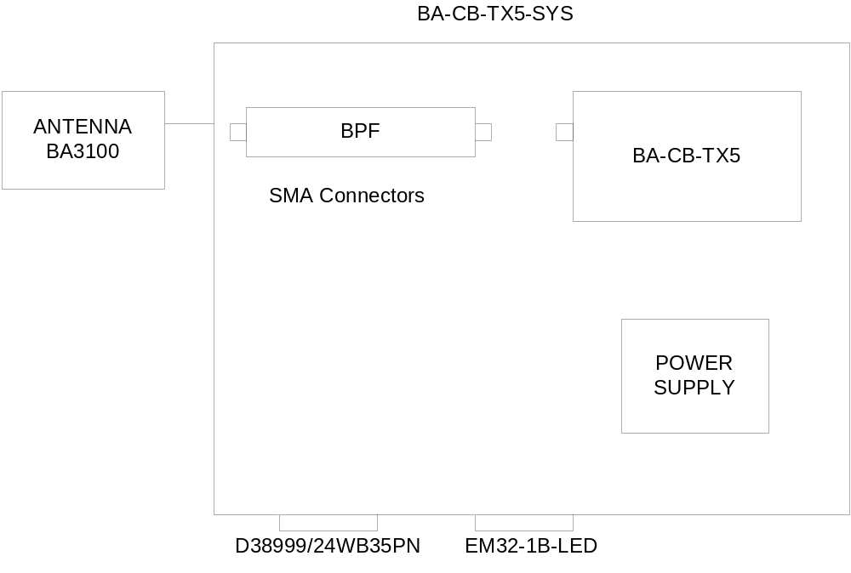
Mechanical Block Diagram- TX

Slide 19
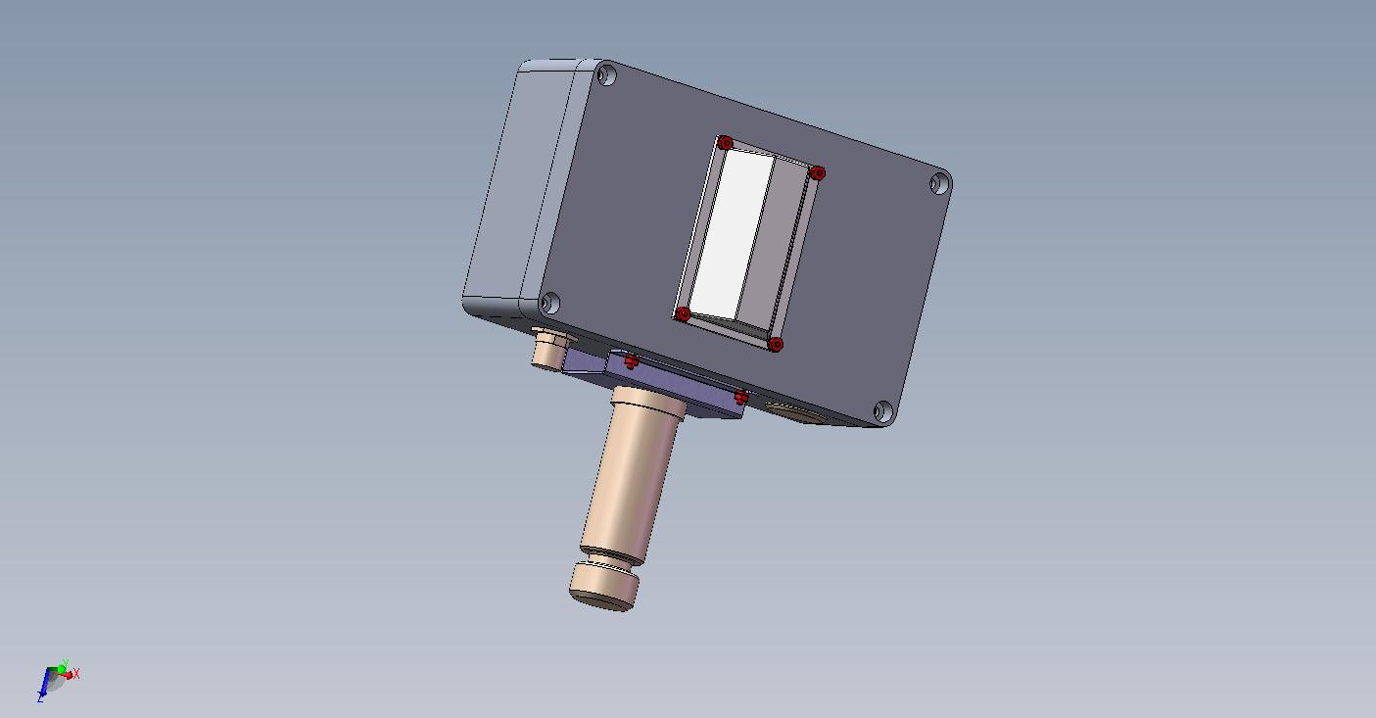
Mechanics TX

Slide 20
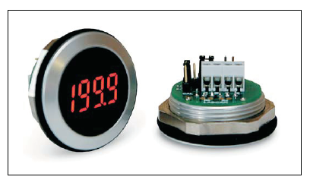
Mechanics Tx
LED shows RF Output power indication
Led Can be turned off via RS422 Control

Slide 21
Mechanics-RX
D38999/24WB35PN (
Supply voltage
Supply voltage
Supply returned/ GND
Supply returned/ GND
Mod out RS422 (+)
Mod out RS422 ( -)
Control OUT RS422 (+)
Control OUT RS422 (-)
Control In RS422 (+)
Control In RS422 (-)
GND
NC
NC

Slide 22
Mechanics Rx - Cont
Weight:2.8Kg Excluding Electronics . ~3.2Kg Final
IP65
Based on Box model:
Color : White
    MIL-C-85285 POLYURETHANE WHITE GLOSS 17925 PER FED-STD-595
Carry on case supplied by customer

Slide 23
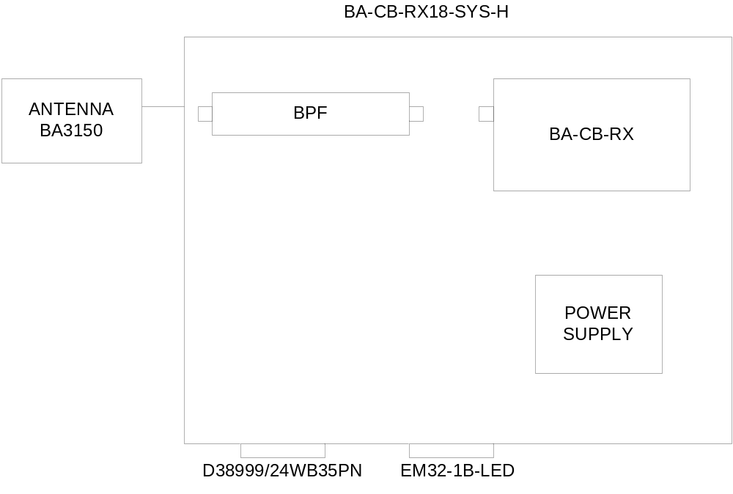
Mechanical Block Diagram- RX

Slide 24
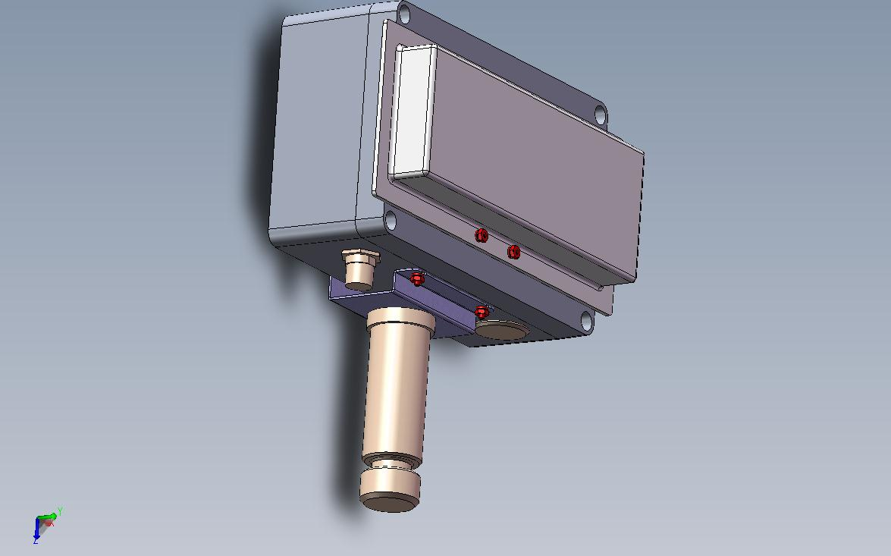
Mechanics RX

Slide 25
Mechanics Rx
LED shows Received power indication
Led Can be turned off via RS422 Control

Slide 26
SOFTWARE
RS422 : 38.4KB , 1, 8, 1 NONE
$ protocol according to protocol Document
Controlled parameters:
  Output power
  STBY mode
  Frequency set
  BAR GRAPH on / off
  Status

Slide 27
Additional first unit tests
First stage: Integration tests
2nd stage: RF emissions in B.A.
3rd stage: Salt Fog.
B.A. to supply IR and FANGUS declaration

Slide 28
Unit tests
Each unit will pass the following tests
ESS including
  Temperature cycles
  6GRMS vibration
ESS on the transmitter and receiver on full unit
ATP on units
Antenna tests VSWR .

Slide 29
Open issues
Final Color Number :
Box Marking :
Close Protocol:

Slide 30
Expected Schedule
MILE STONE | Schedule
Prototype | 23.8.2012
Prototype tests | 27.8.2012
QUAL : | ?????
SUPPLY of ALL UNITS | 30.9.2012

